Slide 1
Machine Learning: Genetic Algorithms
Michael Lensi
Albuquerque, NM
2017
Notes:
By the end of this presentation, you will be able to make a GA from scratch.

Slide 2
Presentation Outline
Example Problem
What is a GA?
Genetics 101
The “Genetics” in Genetic Algorithm
The “Algorithm” in Genetic Algorithm
The inVEETro Global Optimizer
Closing Remarks

Slide 3









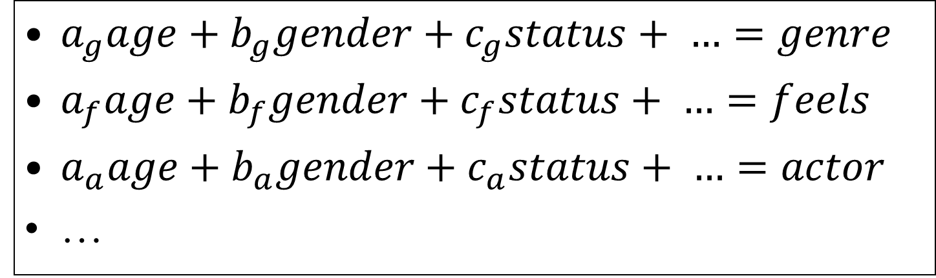
Example Problem
$a_{g}age+b_{g}gender+c_{g}status+ …=genre$
$a_{f}age+b_{f}gender+c_{f}status+ …=feels$
$a_{a}age+b_{a}gender+c_{a}status+ …=actor$
…

Slide 4
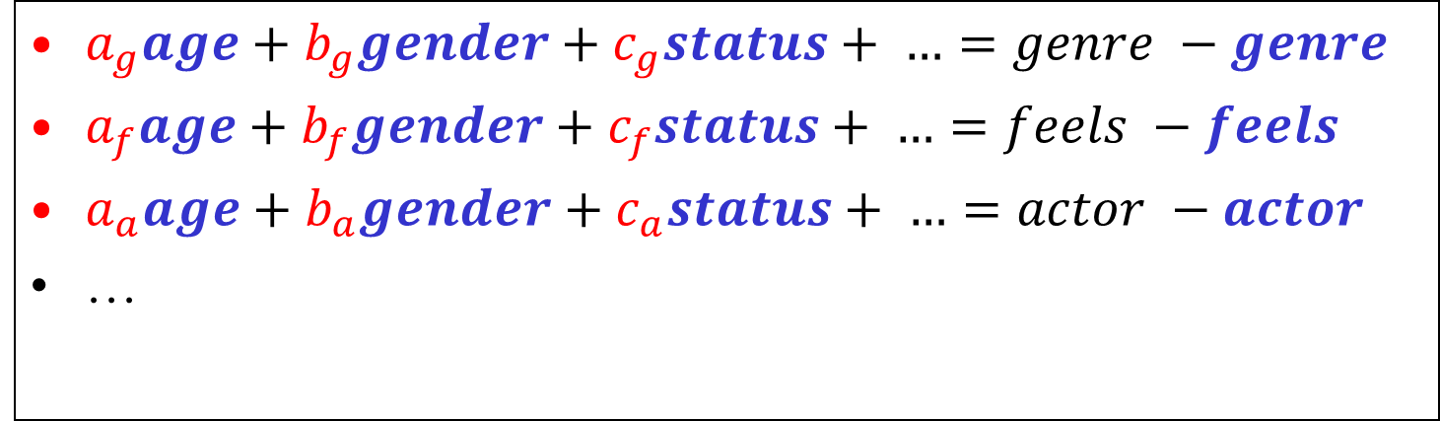
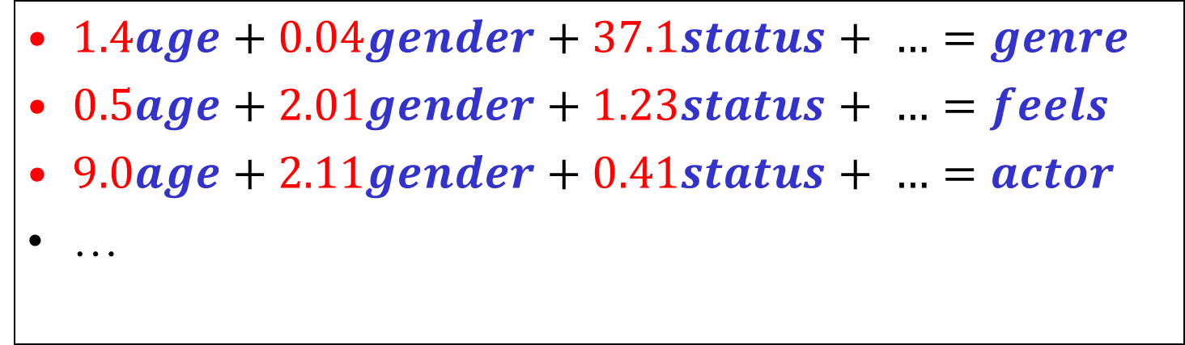
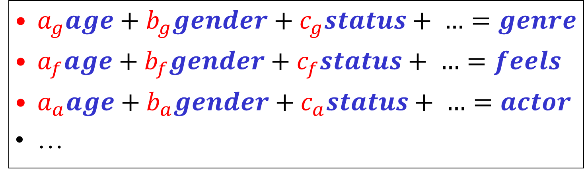
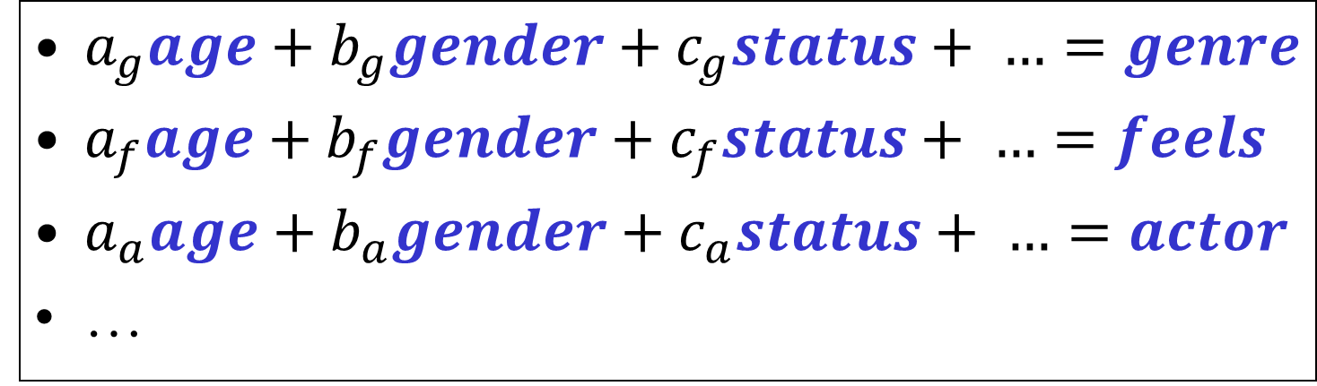
Example Problem
$a_{g}age+b_{g}gender+c_{g}status+ …=genre$
$a_{f}age+b_{f}gender+c_{f}status+ …=feels$
$a_{a}age+b_{a}gender+c_{a}status+ …=actor$
…
$a_{g}age+b_{g}gender+c_{g}status+ …=genre$
$a_{f}age+b_{f}gender+c_{f}status+ …=feels$
$a_{a}age+b_{a}gender+c_{a}status+ …=actor$
…
$1.4age+0.04gender+37.1status+ …=genre$
$0.5age+2.01gender+1.23status+ …=feels$
$9.0age+2.11gender+0.41status+ …=actor$
…
$a_{g}age+b_{g}gender+c_{g}status+ …=genre −genre$
$a_{f}age+b_{f}gender+c_{f}status+ …=feels −feels$
$a_{a}age+b_{a}gender+c_{a}status+ …=actor −actor$
…

Slide 5
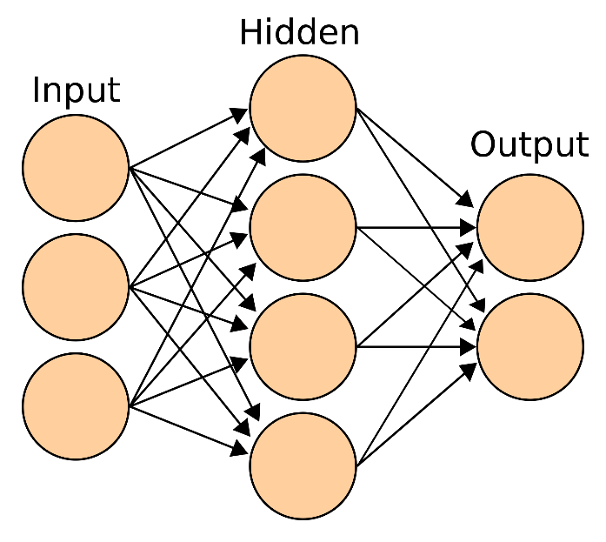
Example Problem
age
genre
gender
feels
status
…
…

Slide 6




What is a GA?
Introduction | Optimization | How are they used? | Brief Example
A GA is an:
adaptive
global
stochastic
optimizer
Used on any problem for which the following can be defined:
fitness function
digital solution space
more

Slide 7
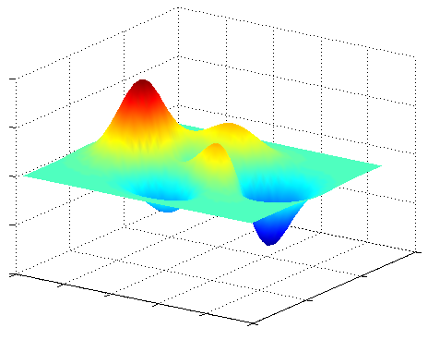
What is a GA?
Introduction | Optimization | How are they used? | Brief Example
A GA is an:
adaptive
global
stochastic
optimizer
Used on any problem for which the following can be defined:
fitness function
digital solution space
Notes:
This animation represents “brute-force” optimization, or grid-sampling.

Slide 8
What is a GA?
Introduction | Optimization | How are they used? | Brief Example
A GA is an:
adaptive
global
stochastic
optimizer
Used on any problem for which the following can be defined:
fitness function
digital solution space
Notes:
This animation represents gradient methods, the most traditional form of optimization.

Slide 9
What is a GA?
Introduction | Optimization | How are they used? | Brief Example
A GA is an:
adaptive
global
stochastic
optimizer
Used on any problem for which the following can be defined:
fitness function
digital solution space
Notes:
This animation represents the GA.

Slide 10
What is a GA?
Introduction | Optimization | How are they used? | Brief Example
A GA is an:
adaptive
global
stochastic
optimizer
Used on any problem for which the following can be defined:
fitness function
digital solution space
a process:
-function
-simulation
fitness
function

Slide 11
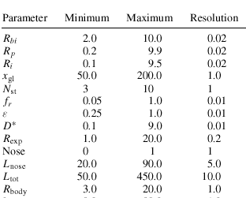
What is a GA?
Introduction | Optimization | How are they used? | Brief Example
ProNav, A/P,
AeroDesign,
SRM Sim., 6-DOF
apportioned
pareto
optimality
fitness
corresponds to a digital solution space of 1.8*10^49
the GA eventually tested 7500 solutions
miss distance
intercept time
takeoff weight
maximum g-loading
… … … ...
data from M. B. Anderson, et. al., Design of a Guided Missile Interceptor Using a Genetic Algorithm, JOURNAL OF SPACECRAFT AND ROCKETS, Vol. 38, No. 1, January – February 2001, with permission
Notes:
The earth is 1.4 * 10^17 seconds old. The universe is not even an order of magnitude large than that.

Slide 12
Presentation Outline
What is a GA?
Genetics 101
The “Genetics” in Genetic Algorithm
The “Algorithm” in Genetic Algorithm
The inVEETro Global Optimizer
Closing Remarks

Slide 13
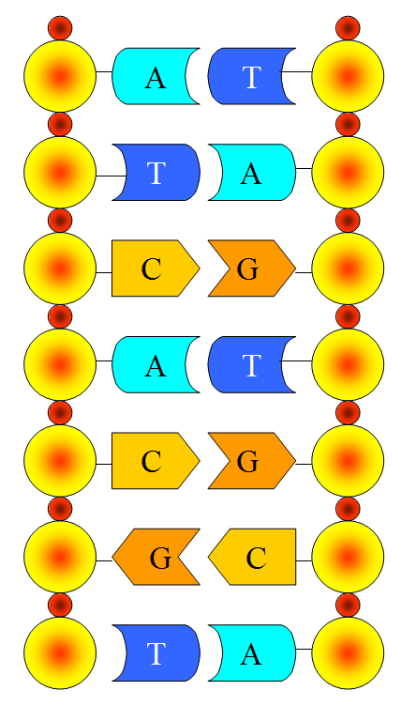
Genetics 101
Introduction | Genes | Variation Mechanisms
Information coding within living organisms
chromosomes (DNA)
genes :: proteins
codons :: amino acids
Two basic forms of information variation
meiosis
mutation
codon
gene
phosphate
base
deoxyribose
nucleotide
more

Slide 14
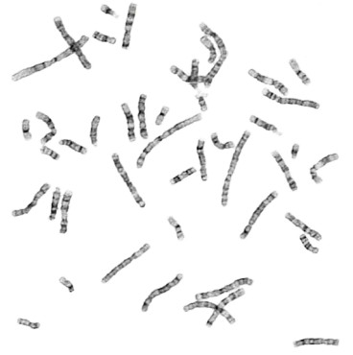
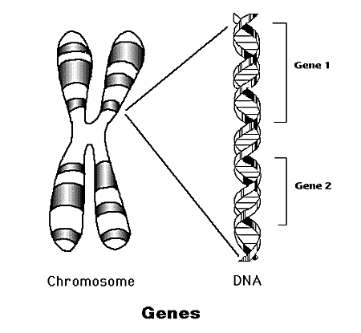
Genetics 101
Introduction | Genes | Variation Mechanisms
A gene is said to be a sequence of codons, which codes for a protein
An allele is said to be a sequence of codons, which codes for a protein
The difference:
a gene represents a location on the chromosome and an allele is a variant of the gene, a variant at that location
I’m 1500 nucleotides long and I make melanin!
Together we help determine skin color!
Notes:
Here, the “cistron” definition of gene is employed, as in molecular genetics. This is as opposed to the Mendelian definition, as in classical genetics. One trick to understanding the difference between “gene” and “allele” is realizing how tremendously long a gene is (large amount of nucleotides). The nucleotide sequences of two different genes are so much more dissimilar than two alleles of the same gene. In a sense, a gene could be defined as the set of alleles that occur at a particular location on a chromosome.
Another trick is to consider what three alleles of the same gene look like—the same. So you can point to a gene—a location on a chromosome; a series of nucleotides—but you can not see what allele it is without more magnification.
Clarification on a confusing issue: when it is said that a gene’s function is independent of its location on the chromosome, this only means that it may work in concordance with other genes quite far away from itself on the chromosome.

Slide 15
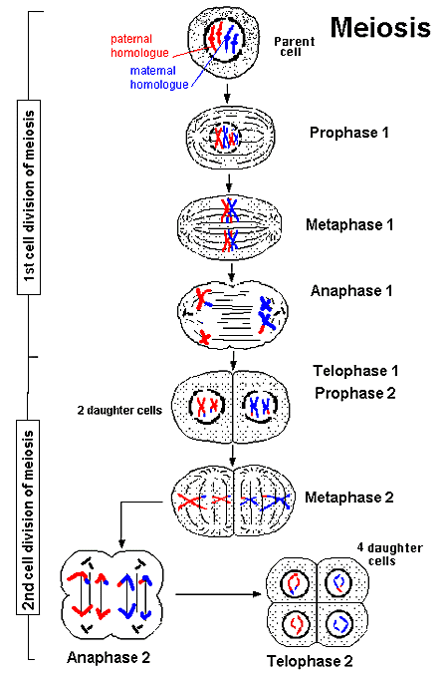
Genetics 101
Introduction | Genes | Variation Mechanisms
Meiosis
copying mechanism of germ-line cells
trades previously-used alleles between chromosomes
Mutation
internal “errors” or environmental effects
can create new alleles
Allele X
Notes:
For another layer of complexity, consider the field of “epigenetics”.

Slide 16
Genetics 101
Meiosis
Mutation
0
1
0
1
0
1
0
Introduction | Genes | Variation Mechanisms
1
0
0
Allele X
0
1
0
1
1
1
1
1
1
1
1
1
0
0
0
1
0
1
0
0
1
0
0
=
0
0
0
1
0
...
1
0
1
0
1
1
1
1
1
1
1
0
0
1
0
0
0
0
$a_{g}age+b_{g}gender+c_{g}status+ …=genre −genre$
$a_{f}age+b_{f}gender+c_{f}status+ …=feels −feels$
$a_{a}age+b_{a}gender+c_{a}status+ …=actor −actor$
…
1
0
0
0
1
1
0
0
0
0
0
0
0
0
1
1
0
1
1
1
1
Notes:
For another layer of complexity, consider the field of “epigenetics”.

Slide 17
Presentation Outline
What is a GA?
Genetics 101
The “Genetics” in Genetic Algorithm
The “Algorithm” in Genetic Algorithm
The inVEETro Global Optimizer
Closing Remarks

Slide 18
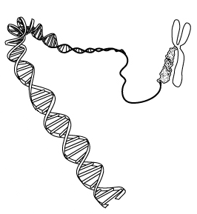
The “Genetics” in GA
Bio Nomenclature | GA Nomenclature
Molecular genetics
a chromosome is a strand of genes
“string” of chemicals
a gene is a “protein controller”
an allele codes for a protein
a group of genes* codes for each physical characteristic
a set of chromosomes code for an entire being
skin color genes
melanin gene
more
*Plus environmental affects. Such a grouping of genes is known as a polygene.
Notes:
Here again, the meaning of “gene” is that of a “cistron”. Also note, a chromosome is not a continuous strand of genes, for non-gene nucleotides exist between genes. Also note, sometimes an allele codes for a partial protein (polypeptide) or some other product.

Slide 19
The “Genetics” in GA
Bio Nomenclature | GA Nomenclature
Genetic Algorithms
a chromosome is a strand of genes
a vector, usually binary
a gene is one bit
an allele is 0 or 1
a group of genes codes for a parameter (independent variable)
each chromosome codes for an entire solution, or possible design
1
“gene” 1 “gene” 2
0
1
0
missile body radius genes
skin color genes
0
1
1
melanin gene
Notes:
Some nomenclatures equate “gene” to “parameter”, by definition. In the above example, then, “missile body radius” would be one “gene”.

Slide 20
Presentation Outline
What is a GA?
Genetics 101
The “Genetics” in Genetic Algorithm
The “Algorithm” in Genetic Algorithm
The inVEETro Global Optimizer
Closing Remarks

Slide 21
The “Algorithm” in GA
Initialize | Decode | Evaluate Fitness | Select Survivors | Mating
1
1
0
0
1
0
0
1
0
0
C_{V} = [-6:2:6]
C_{A} = [0.3:0.1:1.0]
C_{V,A} = [-1.0:0.1:-0.3]
C_{T} = [-1:1:1]
Save to
history
0
0
1
1
0
0
1
0
Calculate
statistics
0
1
GAdat, sol
H
P
1
1
1
1
1
1
1
1
1
1
0
0
1
1
0
0
1
0
0
1
Initialize
population
X
0
0
0
0
0
1
0
0
Select
survivors
=
1
0
S
Mating
1
1
0
0
1
0
0
1
0
...
0
...
-2 -6 4 …
0.3 0.4 1.0 …
-0.7 -0.9 -0.5 …
0 0 1 ...
1
1
1
1
1
1
1
1
1
1
.1 .09 .8 ...
Xdec
0
0
0
0
0
1
0
0
1
0
Decode
population
Evaluate
fitness
0
0
1
1
0
0
1
1
0
0
f
0
0
0
0
0
0
0
0
0
0
1
1
1
1
1
0
1
1
0
1
Flow diagram for the inVEETro Global Optimizer v2.0

Slide 22
The “Algorithm” in GA
Initialize | Decode | Evaluate Fitness | Select Survivors | Mating
Save to
history
Calculate
statistics
GAdat, sol
H
P
Initialize
population
X
Select
survivors
S
Mating
Xdec
Decode
population
Evaluate
fitness
f
Flow diagram for the inVEETro Global Optimizer v2.0
Notes:
Do not forget the important concept of “elitism”. Advanced algorithm concepts not illustrated include N-point crossover, adaptive N-point crossover, accidentals, non-banding mutation, self-optimizing GA’s, between gene/parameter breakpoint selection, etc.

Slide 23
The “Algorithm” in GA
GA Controls
Number of Chromosomes
the number of solutions (organisms) per generation
each solution will be evaluated for fitness
Number of Generations
provides a stopping criterion for the algorithm
Survival Rate
percentage of organisms that survive to reproduce
Top Member Mating Frequency
controls the frequency with which the most fit survivors will mate with the other survivors
Mutation Rate
each bit’s probability of mutating
1
0
1
1
0
0
1
0
0
1
1
0
1
1
0
1
0
1
0
0
1
1
0
1
1
0
1
1
0
0
0
0
1
0
1
0
1
1
1
1
0
0
0
1
0
1
0
0
1
0
1
1
1
0
0
1
0
1
0
0
1
1
0
0
1
0
0
1
0
0
1
1
1
1
0
0
1
1
0
1
1
1
0
0
0
0
1
1
0
1
0
1
1
1
1
0
1
1
0
0
0
0
1
1
0
1
0
These controls apply specifically the inVEETro Global Optimizer v2.0, but are representative of GA’s in general.

Slide 24
Presentation Outline
What is a GA?
Genetics 101
The “Genetics” in Genetic Algorithm
The “Algorithm” in Genetic Algorithm
The inVEETro Global Optimizer
Closing Remarks

Slide 25
Closing Remarks
Advantages & Disadvantages | Biology & Engineering
Efficient for massive solution spaces
Independent of problem
complex problems
loosely defined problems
Global, if tuned correctly
Gradients not necessary
Must be tuned to work efficiently
mutation rate
survival rate
mating frequency
May not find true optimal point in the solution space

Slide 26
Closing Remarks
Advantages & Disadvantages | Biology & Engineering
Biomimetics (the owl and the stealth aircraft)
Ant Colony Optimization
Particle Swarm Optimization
Computer Immune Systems
“It is now clear that evolution is one of the very best techniques we have in computer science--it regularly outperforms traditional methods that were carefully created by researchers.” -Peter J. Bentley, Digital Biology

Slide 27
Thank You
For More Information on GA’s / Machine Learning / AI:
michael.lensi@ruralsourcing.com
“An Introduction to Genetic Algorithms” by Melanie Mitchell, MIT Press
“Design of a Guided Missile Interceptor Using a Genetic Algorithm”, AIAA JSR, Vol. 38, No. 1, 2001
Hierarchical Temporal Memory (HTM)
https://numenta.com
“On Intelligence” by Jeff Hawkins

